Slide 2
National Census Day >> April 1, 2020
What’s New for 2020?
Internet and phone responses
Greater reliance on technology
Current state of the country

Slide 3
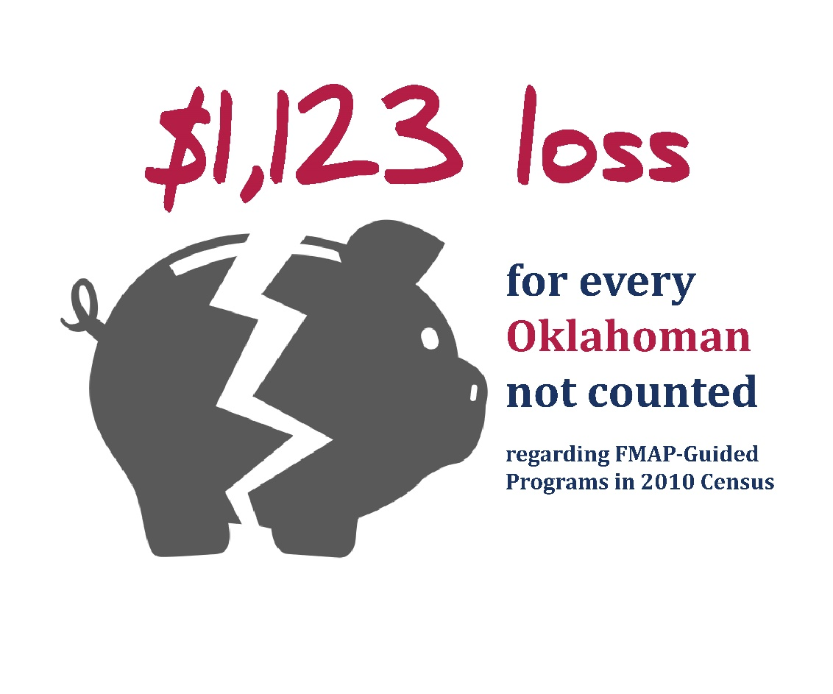
Why the Census matters

Slide 4
Why should I complete the Census?
It's important
It's easy
It's safe
It's required
It's absolutely confidential

Slide 5
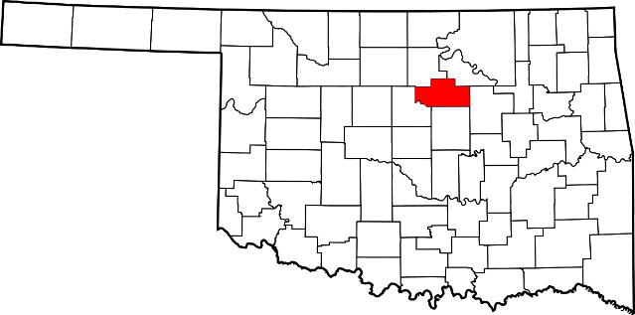
An accurate Census count is important to Payne County
Accurate Census counts can benefit:
OSU Transit
Stillwater Public Schools
Stillwater Chamber of Commerce
City of Stillwater

Slide 6
20 ways Census Data are Used Nationwide
Decision making at all levels of government.
Drawing federal, state, and local legislative districts.
Attracting new businesses to state and local areas.
Distributing over $300 billion in federal funds and even more in state funds.
Forecasting future transportation needs for all segments of the population.
Planning for hospitals, nursing homes, clinics, and the location of other health services.
Forecasting future housing needs for all segments of the population.
Directing funds for services for people in poverty.
Designing public safety strategies.
Development of rural areas.
Analyzing local trends.
Estimating the number of people displaced by natural disasters.
Developing assistance programs for American Indians and Alaska Natives.
Creating maps to speed emergency services to households in need of assistance.
Delivering goods and services to local markets.
Designing facilities for people with disabilities, the elderly, or children.
Planning future government services.
Planning investments and evaluating financial risk.
Publishing economic and statistical reports about the United States and its people.
Facilitating scientific research.

Slide 7
How the 2020 Census will invite everyone to respond
Every household will have the option of responding online, by mail, or by phone.
The 2020 Census has special procedures to count people who don’t live in households, such as students living in university housing or people experiencing homelessness.
95%
of households will receive their census invitation in the mail
4-5%
of households will receive their census invitation when a census taker drops it off
<1% of households will be counted in person by a census taker, instead of being invited to respond on their own

Slide 8
Where are people counted?
Homeowners, Renters and Household Members with One Residence
The will be counted at this residence, even if they are not physically there on April 1, 2020, due to a temporary visit elsewhere.
Find more on where people are counted at paynecountycensus.org

Slide 9
Where are people counted?
Temporary Residents, Vacationers, Multi-Home Owners and “Snowbirds”
Each housing unit will receive census mailers, but the “head of household” will respond using the address of their usual residence.
Children under shared-custody will be counted at the residence where they live and sleep most of the time.
In cases of equally-shared custody, children will be counted where they are present on April 1, 2020.
Find more on where people are counted at paynecountycensus.org

Slide 10
Where are people counted?
Non-Citizens
If they are living in the U.S., they will be counted at their usual residence.
Tourists, business travelers or other temporary visitors will not be counted.
Find more on where people are counted at paynecountycensus.org

Slide 11
Where are people counted?
Residents of Group Facilities
They will be counted at the facility in which they are housed or living on Census Day.
For example, a resident of a nursing home will be counted at the facility where he or she lives.
Find more on where people are counted at paynecountycensus.org

Slide 12
Where are people counted?
Active Military Personnel and Families
If they are stationed at a military installation in the U.S., they will be counted at their usual residence either on-base or off-base.
If they are stationed overseas, they will be counted as part of the federally-affiliated overseas population, conducted in partnership with the U.S. Department of Defense using administrative records.
If they are stationed stateside but deployed overseas during the census, they will be counted at their usual residence in the U.S.
If they are aboard a military vessel, they will be counted at either their usual U.S. residence or as a part of the federally-affiliated overseas population — depending on whether the vessel’s homeport is in the U.S. or overseas.
Find more on where people are counted at paynecountycensus.org

Slide 13
Where are people counted?
College and Boarding-School Student
College students living on campus or in off-campus housing will be counted at school facilities or at their off-campus housing, even if they visit home on holidays and breaks.
If they commute, they will be counted at their usual residence.
If they are attending a school outside the U.S. and living abroad, they will not be counted.
Boarding school students will be counted at their parents’ home.
Find more on where people are counted at paynecountycensus.org

Slide 14
Spring 2019
Hiring of in-field address canvassers
Aug. 19, 2019
In-field address canvassing begins
September 2019 – April 2020
Hiring of enumerator
March 2020
Census postcards are sent to most homes
March 12 – 20, 2020
Mailing 1: Letter with info to take survey online (the majority of people will get this)
March 16 – 24, 2020
Mailing 2: Reminder letter to non-respondents
March 26 – April 3, 2020
Mailing 3: Postcard to non-respondents
April 2020
Mailing 4: Letter + questionnaire to non-respondents
April 2020
Mailing 5: “It’s not too late” postcard to non-respondents
Dec. 31, 2020
The Census director delivers apportionment counts to the president
March 2021
The Census Bureau completes delivery of redistricting counts to the states
Census Timeline

Slide 15
What if I am away from my residence on April 1, 2020?
Will a Census worker come to my door?
Are my answers safe and secure?
Do I have to participate in the survey?
When will the results from the Census be available?

Slide 16
Find more information at
paynecountycensus.org

